Slide 1
Chat Bot
By,
Coding Minds- Pujita Mullapudi
Namrata dutta
Srinivas Potluri
saidu babu dosapati

Slide 2
Introduction
Chat Bot is an Artificial Intelligence application which generates human-like conversations in the form of text or audio.
We have used Python as the programming language.
The responses are generated from known conversations implemented as training collections.
The Chat Bot responds to normal greeting conversation, information about your school and also information about the weather outside.

Slide 3
How it works
The packages required for running it are – Flask, Chatterbot, SQLALchemy.
We are using SQLLite as the database for storing the training data for the ChatBot to refer the known conversations.
Each time the user enters a text, the library saves the text and the response, so that it replies very accurately next time.
As soon as the input is entered by the user, the program selects the nearest matching response and returns the same.

Slide 4
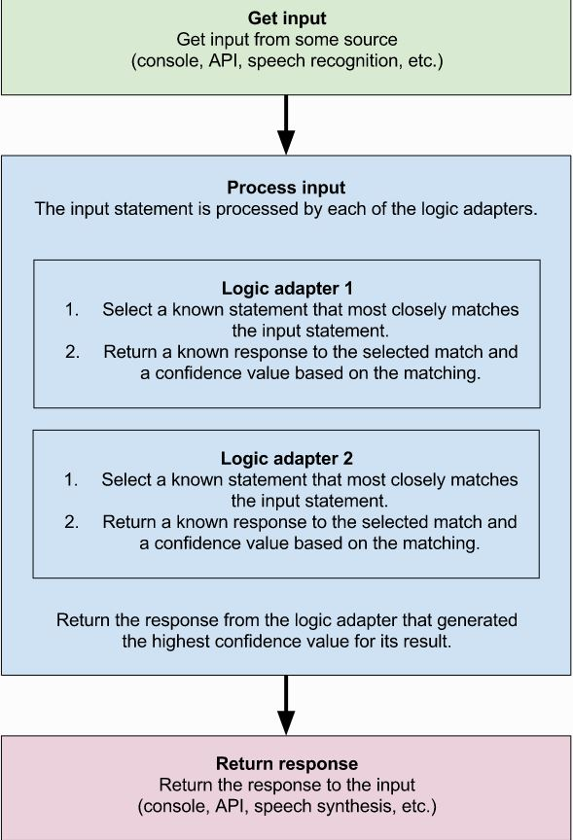
Process

Slide 5
Installation Requirements
Pip should be installed
Pip install chatterbot
Flask package is required
We have used SQL Alchemy package for storing the texts

Slide 6
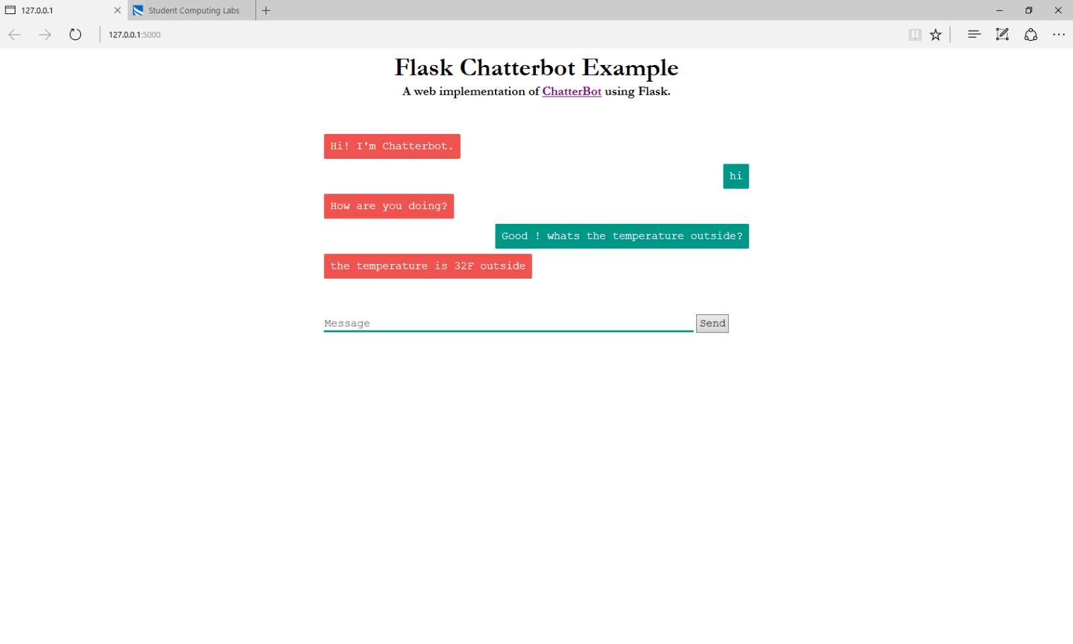
Implementation
Youtube link: https://youtu.be/xj4lyZr0uaY

Slide 7

Thankyou

